Slide 1
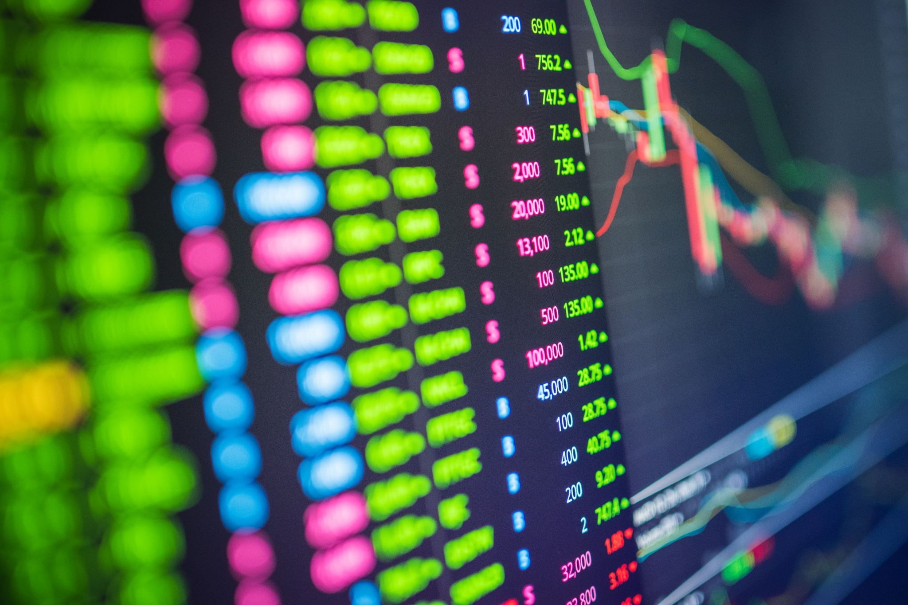
STOCK PRICE PREDICTION
LIKITH KAGITA
SAI KUMAR REDDY
ROHITH ABBURI

Slide 2
CONTENT
Machine Learning
Deep Learning
Deep Learning Necessity
Stock Price Dataset
Algorithm
Conclusion
References

Slide 3

ABSTRACT
The demand for stocks has become huge with an Increase in the popularity of stocks in the Digital world. Prediction and Analyzing stock can benefit People to think before buying or selling stocks. So, a new Stock Price Prediction through Deep Learning Algorithms has been analyzed and visualized. Through this System, we can predict any Company stock in the world.

Slide 4
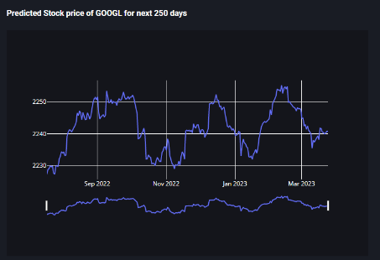
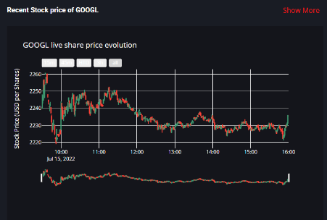
MACHINE LEARNING
Machine learning is the science of getting computers to act without being explicitly programmed.
Machine learning is a method of data analysis that automates analytical model building
Machine learning is important because it gives enterprises a view of trends in customer behavior and business operational patterns, as well as supports the development of new products
METRICS:
-Shows stocks for up to 365 days
-Having an accuracy of around 87%

Slide 5
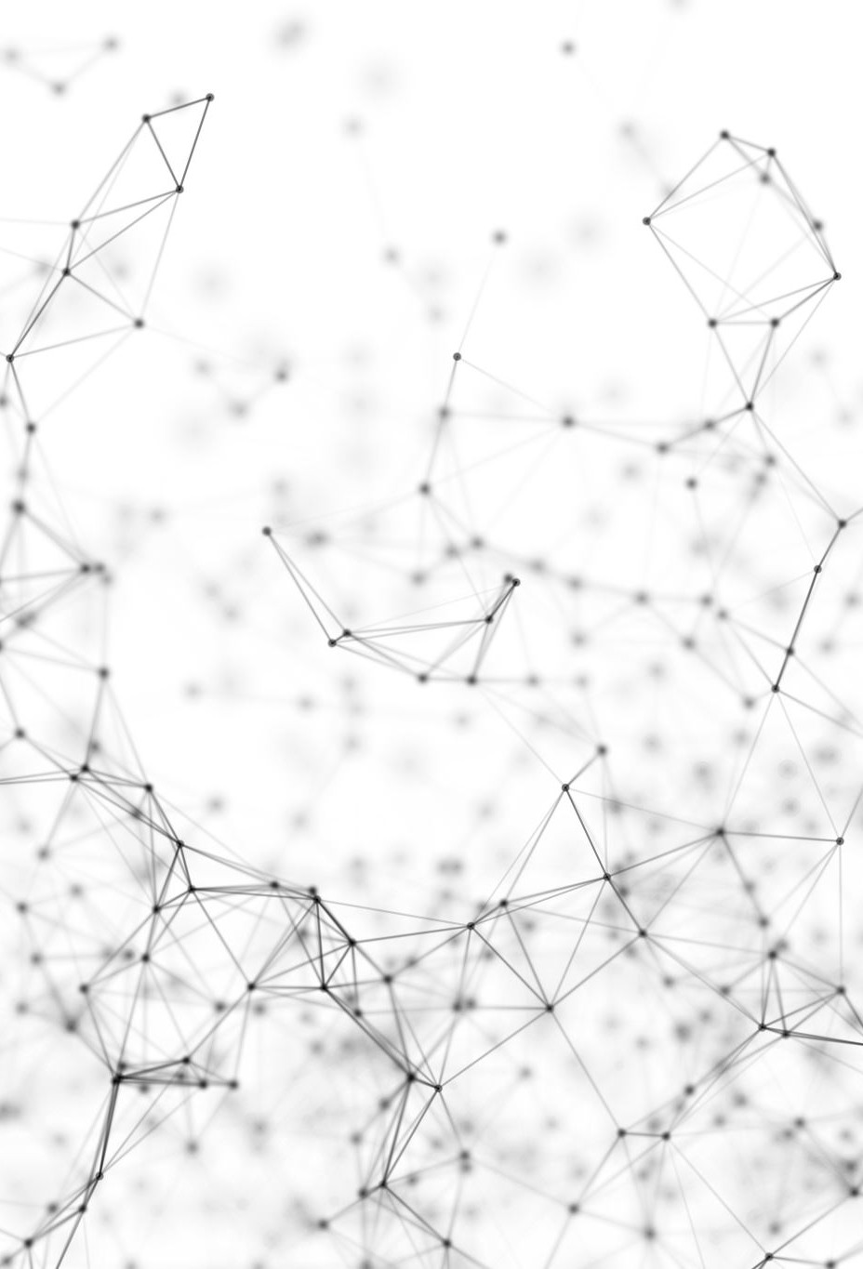
DEEP LEARNING
Deep learning is an artificial intelligence (AI) function that imitates the workings of the human brain in processing data and creating patterns for use in decision making.
Deep learning is a subset of machine learning in artificial intelligence that has networks capable of learning unsupervised from data that is unstructured or unlabeled. Also known as deep neural learning or deep neural network.
Deep learning attempts to mimic the human brain—albeit far from matching its ability—enabling systems to cluster data and make predictions with incredible accuracy.

Slide 6

DEEP LEARNING NECESSITY
Deep learning has evolved hand-in-hand with the digital era, which has brought about an explosion of data in all forms and from every region of the world. This data, known simply as big data, is drawn from sources like social media, internet search engines, e-commerce platforms, and online cinemas, among others. This enormous amount of data is readily accessible and can be shared through fintech applications like cloud computing.
However, the data, which normally is unstructured, is so vast that it could take decades for humans to comprehend it and extract relevant information. Companies realize the incredible potential that can result from unraveling this wealth of information and are increasingly adapting to AI systems for automated support.

Slide 7
STOCK PRICE DATASET
Google is an American multinational technology company that specializes in Internet-related services and products, which include online advertising technologies, a search engine, cloud computing, software, and hardware.
It is considered one of the big four Internet stocks along with AMAZON, FACEBOOK, APPLE (AAPL) and TESLA.
The company is listed on the NASDAQ stock exchange under the ticker symbol GOOGL.
We have used dataset from Yahoo Finance.

Slide 8
ALGORITHM
Machine-Learning Algorithms:
MULTIPLE LINEAR REGRESSION
SEQUENTIAL
DENSE
LSTM
DROPOUT

Slide 9
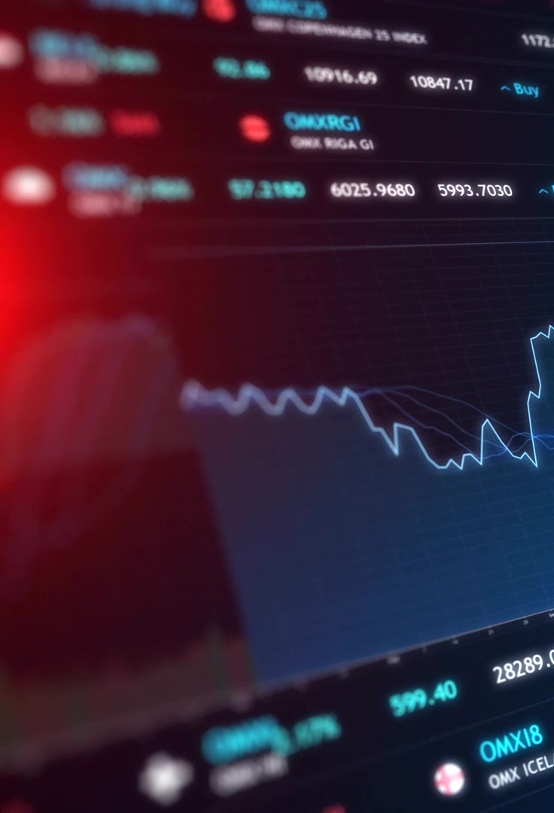
CONCLUSION
How is this project going to be different?
We can see the Prediction, analysis, and Visualization of stock Prices by applying Deep learning algorithms such as LSTM, DENSE, DROP OUT, and SEQUENTIAL.
In the same way, we can use any company Stock Dataset directly and apply this algorithm it will give us the correct prediction.
This System will Successfully run on any system even on Cloud platforms.

Slide 10

REFRENCES
https://machinelearningmastery.com/start-here/#getstarted
https://colah.github.io/posts/2015-08-Understanding-LSTMs/
https://www.sas.com/en_us/insights/analytics/machine-learning.html
https://groww.in/us-stocks/googl
https://www.investopedia.com/terms/d/deep-learning.asp
https://www.nasdaq.com/market-activity/stocks/goog

